Slide 1
SafeWalk
Project Architecture
By Samantha Puterman, Alexandra Pineiro, Byron Mitchell, Jean Marc Achkar

Slide 2
Who is the audience? What is the app’s purpose?
The SafeWalk application is intended for college students coming back from the library at late hours, tourist wandering around an unknown country, and women walking back home from work.
SalfeWalk’s purpose is to track the user’s location and detect any unusual behavior from the user. If such behavior is detected, emergency contacts will be called.

Slide 3
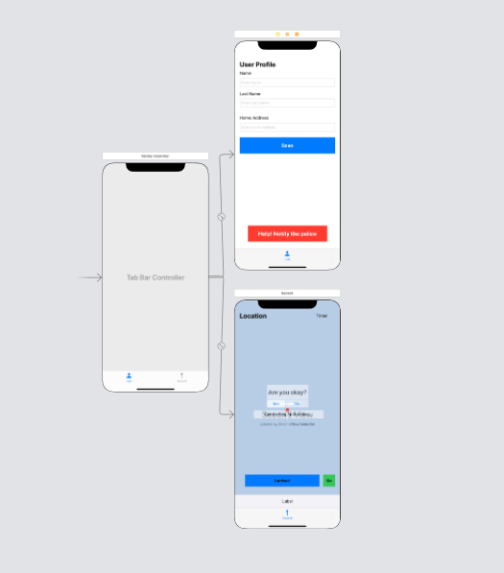
Project Diagram
The app includes two classes:
First View Controller
User Profile
Second View Controller
Location/Map

Slide 4
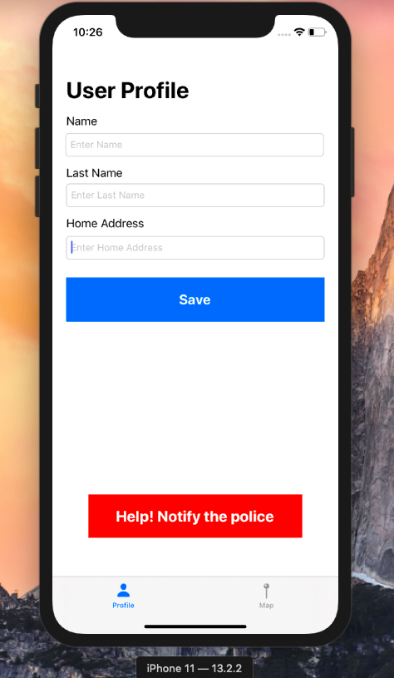
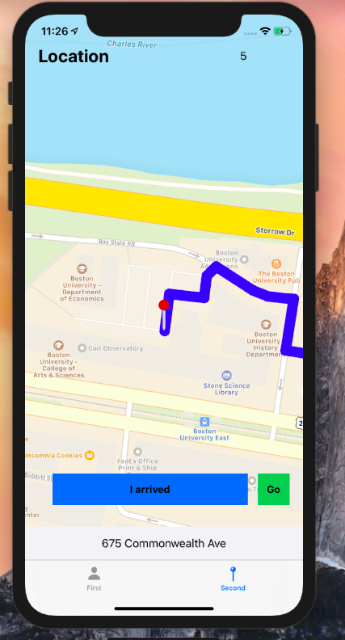
Hitting Map Button
Hitting Profile Button

Slide 5
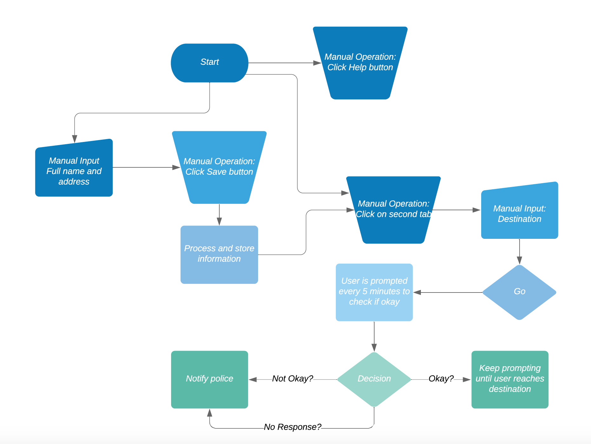
App flow chart

Slide 6
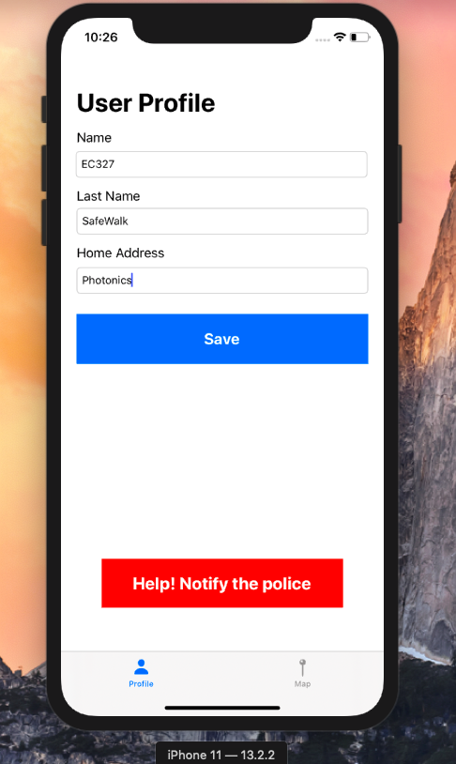
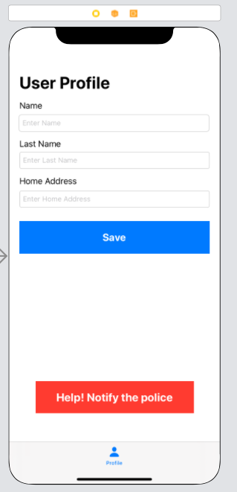
First View Controller

Slide 7
First View Controller
Default screen when the app is opened
The first time the app is opened, the user has to complete the profile by inputting their full name and address.
These fields are saved by pressing the “Save” button, but can be changed at any time.
A “Notify the Police” button is available to be clicked at any time if the user feels that he/she is in danger.

Slide 8
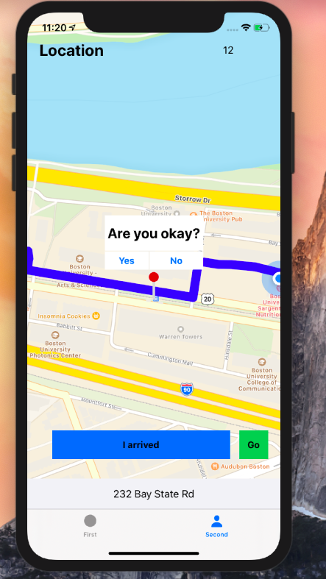
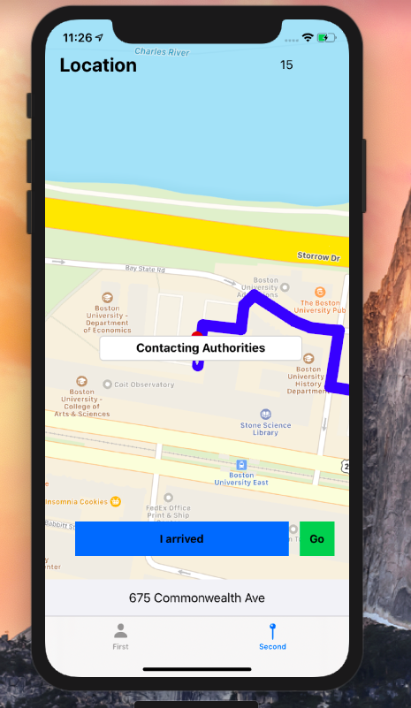
Second View Controller

Slide 9
Second View Controller
Accessed by clicking the map icon on the main tab.
A “Go” button is available for users to click which will generate the “safest” route and initiate a timer for user notification.
Every 5 minutes (might be changed later), the user receives a prompt asking if they feel okay, if the user fails to respond after a certain amount of time, the app will contact the police automatically.
The process ends once the user manually tells the app that they have reached the desired destination by clicking the “I have arrived” button.

Slide 10
App Specs
Safest route determined by traffic
User won’t feel alone walking back home
Free, user-friendly, and easily accessible
The app does not require any type of registration, just the full name, address, and current location that will be used in case of emergency
Useful for:
College students returning from parties (or anywhere) late at night alone
Women who work late night and walk through shady streets to reach home
Tourists visiting foreign country who are not familiar with the region
And many more

Slide 11
Why invest?
By college students, for college students
With funding, add more functionalities and make more user-friendly
Add features such as emergency contact, geocoding, and possible service for nearby people to walk you home.
More accuracy on determining best route
Including other factors that determine safest route
Could save lives!

Slide 12
Thank you

